Slide 1


ROCKBUSTER STEALTH ANALYSIS PROJECT
Rockbuster Stealth LLC
A Movie Rental Comapny

Slide 2

PROJECT OVERVIEW
Company
To compete with other companies, a movie rental company is trying to expand into the worldwide online renting market.
Objective
The management team require answers to business challenges in order to develop a 2020 strategic plan.
Data
The Rockbuster database was utilised for the analysis. The data includes tables pertaining to video collecting information such as customer, film, rental, and film category to name a few.
Tools used Excel, PostgreSQL and Tableau.

Slide 3









DATA OVERVIEW
1000 Films
Film Length
Rental Duration Rental Rate Replacement Cost
185 mins
7
$4.99
$29.99
Maximum
Minimum
46
mins
5
$0.99
$9.99
Average
115.2
mins
3
$2.98
$19.98
2 stores 599 customers. 599 cities. 109 countris.

Slide 4
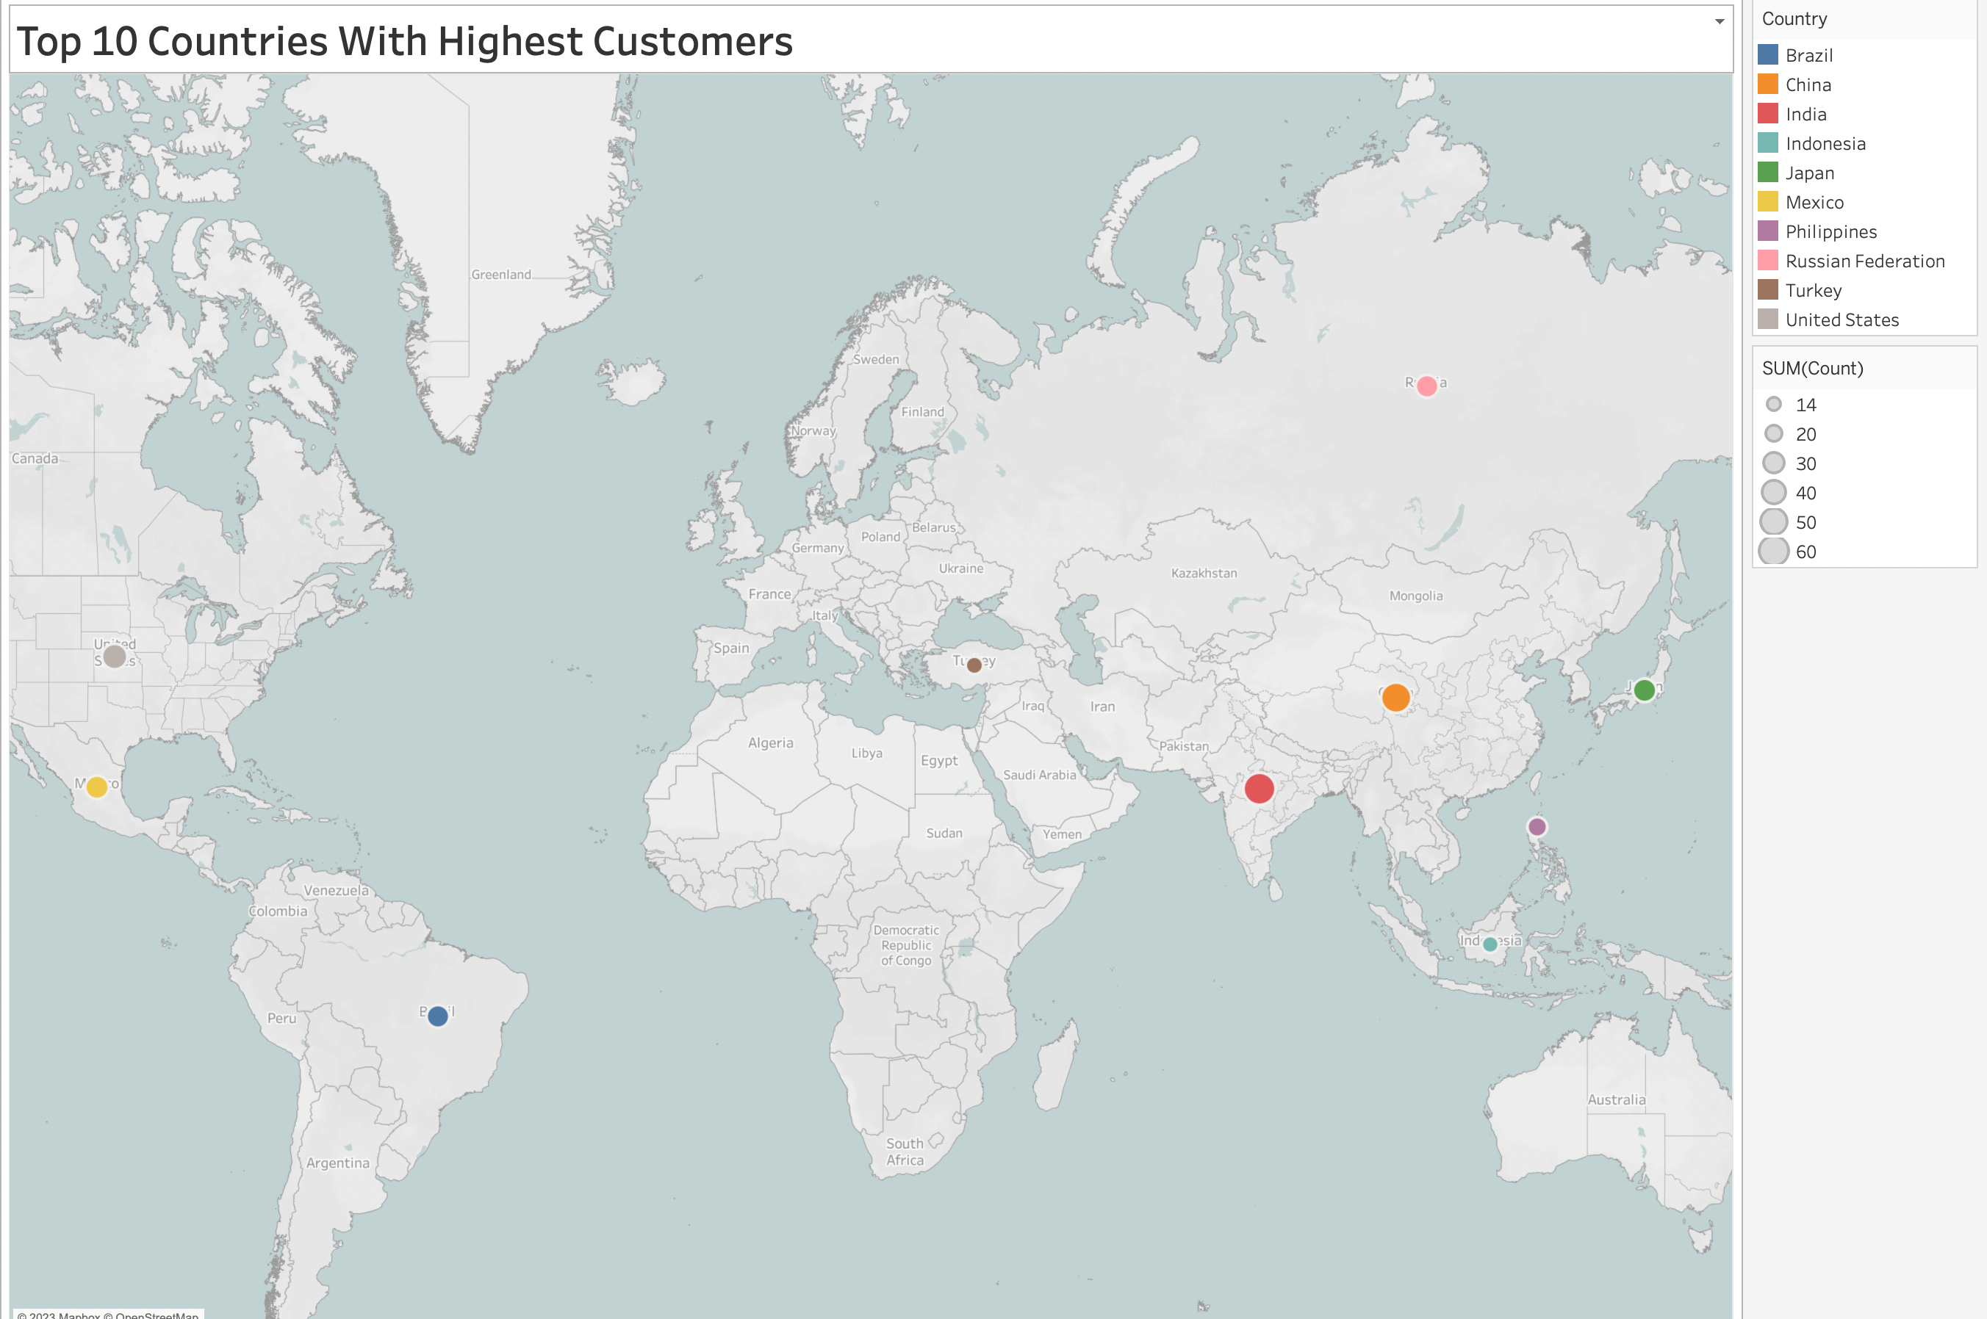
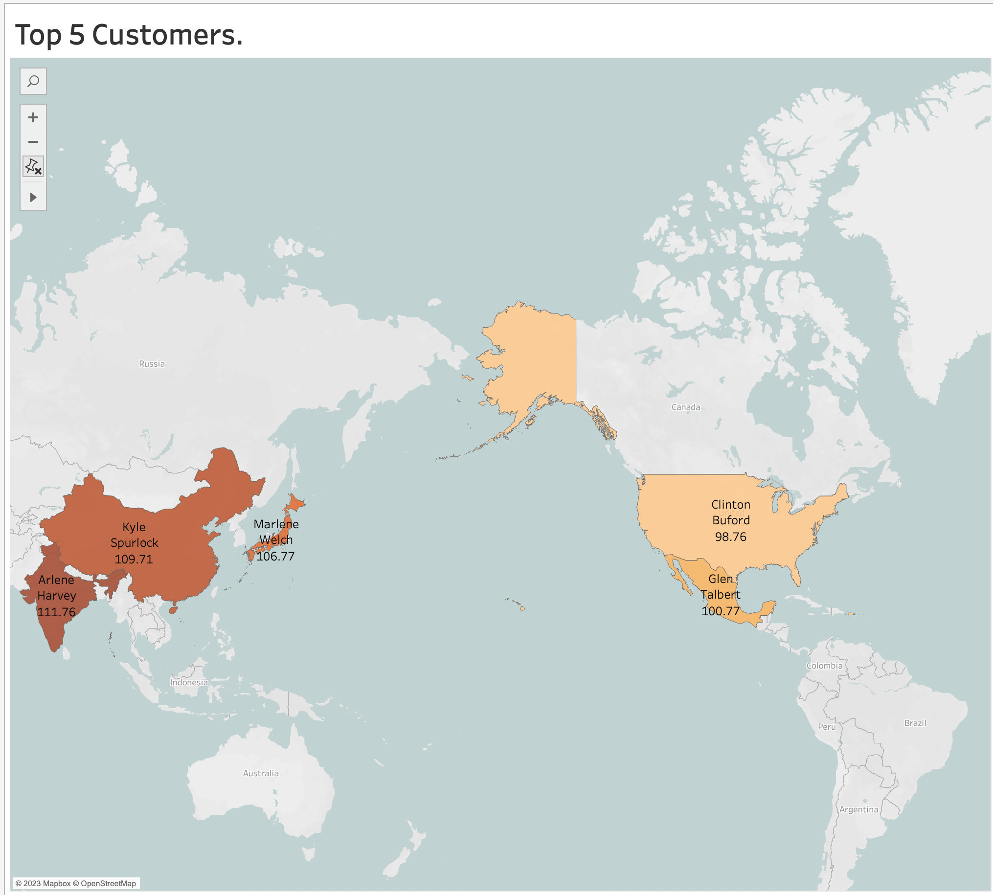
VISUALIZATION INSIGHTS
The top 10 nations by number of Rockbuster customers are represented on a map in this graph. The countries with the most Rockbuster users are BARAZIL, CHINA, INDIA, JAPAN, MAXICO, PHILIPPINES, RUSSIA, TURKEY, AND THE UNITED STATES.
The top 5 customers from the top ten countries that gave Rockbuster the highest overall payment are represented in this graph.

Slide 5
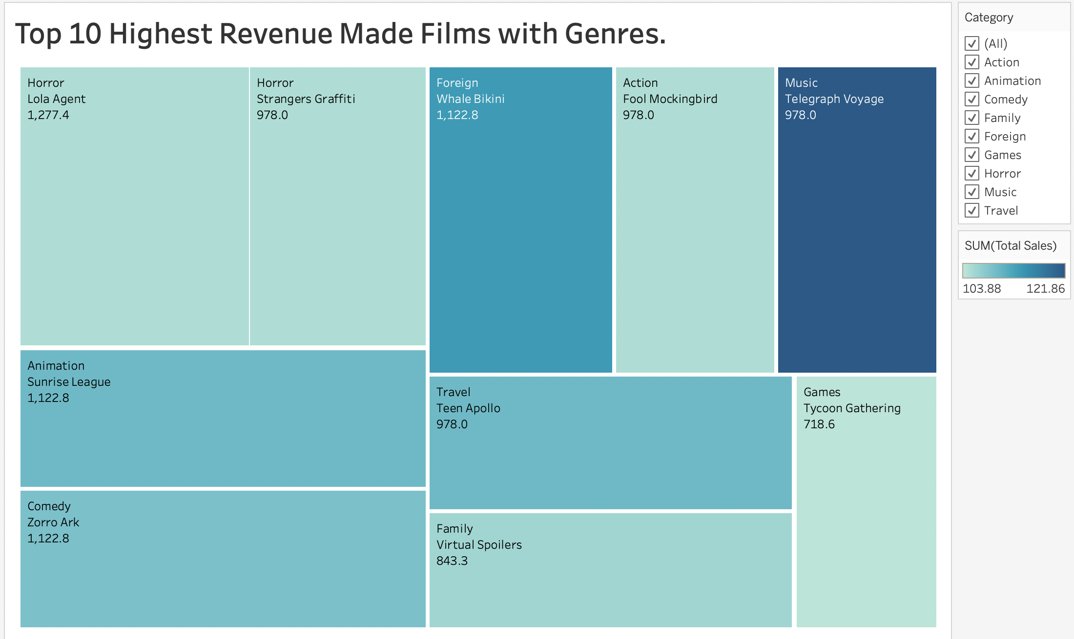
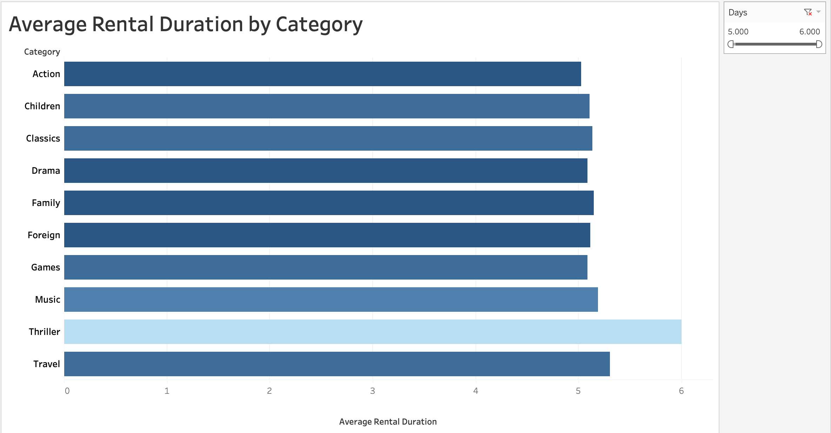
VISUALIZATION INSIGHTS
This treemap graph depicts the top ten highest-grossing films for Rockbuster, with a total revenue of 1277.4 dollars. The Lola Agent is the highest-grossing picture, while The Telegraph Voyage is the best-selling.
This bar graph displays the genre of movie with the longest average rental term, which in this case is a 6-day rental.

Slide 6

Recommendations
To successfully transition from a traditional film rental business to an online platform and effectively compete with other online film rental companies, consider the following recommendations:
User-Friendly Website and App: Develop a user-friendly and intuitive website and mobile app that makes browsing, searching, and renting films a seamless experience. Ensure the interface is responsive, visually appealing, and easy to navigate.
Diverse Film Collection: Offer a vast and diverse collection of films spanning different genres, languages, and eras. Cater to various tastes and preferences, ensuring there's something for everyone.
Personalized Recommendations: Implement a robust recommendation system that suggests films based on users' viewing history, ratings, and preferences. This enhances user engagement and encourages them to explore new titles.
Flexible Subscription Plans: Provide flexible subscription plans catering to different needs, such as unlimited streaming, pay-per-view, or bundled packages. Allow customers to adjust their plans based on their viewing habits.
Exclusive Content and Premieres: Partner with independent filmmakers or acquire exclusive rights to certain films. Hosting premieres and exclusive content can attract dedicated audiences.
Transparent Pricing: Clearly communicate pricing details, including subscription fees, rental costs, and any additional charges. Avoid hidden fees to build trust with customers.

Slide 7

Recommendations
High-Quality Streaming: Invest in robust streaming technology to deliver high-quality video and audio experiences. Smooth playback without buffering issues is crucial for customer satisfaction.
Customer Reviews and Ratings: Integrate a review and rating system for films, allowing users to share their opinions. This adds credibility and helps users make informed choices.
Social Engagement: Utilize social media platforms to engage with your audience. Conduct film-related discussions, contests, and interactive events to build a sense of community around your platform.
Responsive Customer Support: Provide efficient customer support through multiple channels, such as live chat, email, and phone, to address any issues or inquiries promptly.
Partnerships and Promotions: Collaborate with other entertainment-related businesses, such as cinemas or streaming platforms, for cross-promotional campaigns and exclusive offers.
Data Security and Privacy: Assure users of their data security and privacy. Implement strong encryption, secure payment gateways, and transparent data usage policies.
Continuous Innovation: Stay up-to-date with industry trends and emerging technologies. Regularly update your platform with new features and improvements to stay competitive.
By implementing these recommendations, ROCKBUSTER film rental company can create a compelling online presence, attract a loyal customer base, and successfully compete in the dynamic landscape of online film rental services.

Slide 8
Tableau link.
Thank You!
Ayaz Khan a.khan10yt@gmail.com

